Slide 1

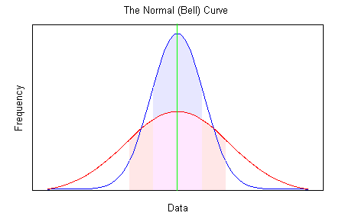
Hypothesis testing in research: Group (mean) comparisons
Shankar Panthi
Xishauangbanna Tropical Botanical Garden
Chinese Academy of Sciences

Slide 2
Content
Data:
Descriptive statistics
Probability distribution
Data transformation
Hypothesis testing: Test statistics
Hypothesis testing: Group (Mean) comparisons

Slide 3

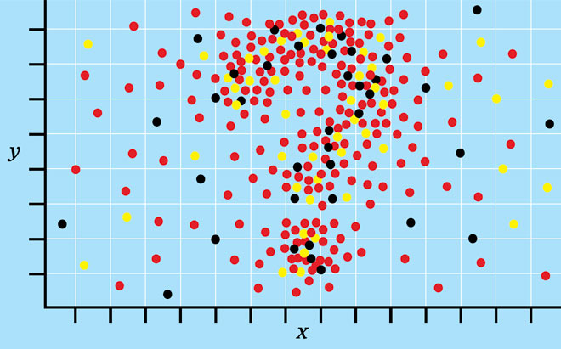
“In God we trust, all others must have data.” -- William Edwards Deming
Data
Data (sing. Datum)- set of values; numbers or numerical information (qualitative and quantitative)
“No statement is a fact unless it is presented by numerical figures.”
Data provide evidence for drawing inference of a research (during hypothesis testing).
(1900-1993)
“Numbers rule the universe.”-- Pythagoras
What do numbers say?

Slide 4
Types of data/variables
[A] Qualitative data (expressed qualitatively, i.e., can not be measured)
Binary or dichotomous: presence/absence (1,0), yes/no (1,0), agree/disagree (1,0); etc.
Nominal scale: Categorization without values or ranks; i.e.
Land cover type (can be coded): grassland (1), shrubland (2), etc.
division by names: colur (black, white), sex (male, female), species, habitat type (assigning count data).
2. Ordinal scale: ranked along continuum in a sequence (highest to lowest/lowest to highest), i.e.;
rare (1), occasional (2), frequent (3), abundant (4), dominant (5)
strongly disagree (1), disagree (2), undecided (3), agree (4) and strongly
3. Interval scale: Equal size intervals, constant interval size (i.e. no absolute zero), interval data of constant measurement (eg. age, date, temp.) etc
4. Ratio scale: measurement of length (eg. height of plant, height of persons), mass, volume, no. of units, length of time (hr, months, yr) etc.
[B] Quantitative data: Can measured in numbers/numerical value i.e. can be added, substracted, multiplied or divided.
Discrete (i.e. integer): count or frequencies, e.g., species richness, no. of students, etc.
Continuous: continuous/non-finite values; e.g., measurement of volume, mass, length, etc.

Slide 5
Descriptive statistics
THE MOST IMPORTANT STEP before hypothesis testing!
Descriptive statistics
(Basis for inferential statistics)
Should be carried out in all dataset
Descriptive statistics
Frequency distribution (Shape)- Histogram, Skewness, Kurtosis
measure of center- e.g., mean, median, mode
measure of dispersion -Standard Deviation, Variance, Range, & Standard Error of Mean.

Slide 6
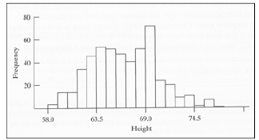
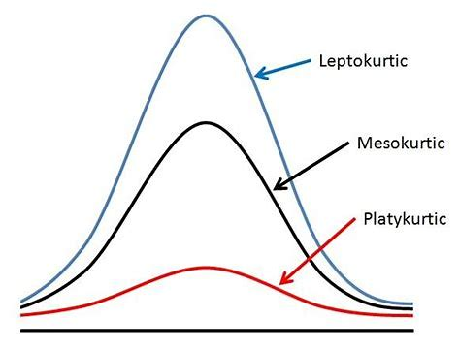
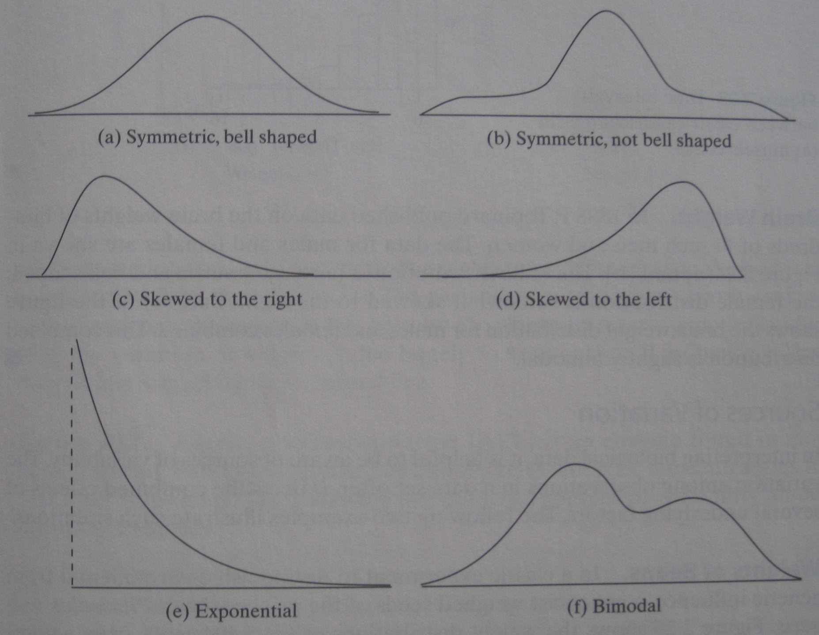
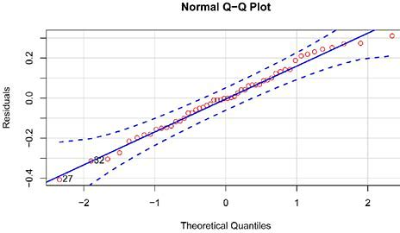
Descriptive statistics: frequency distibution (symmetry)
Histogram
Shape distribution

Slide 7
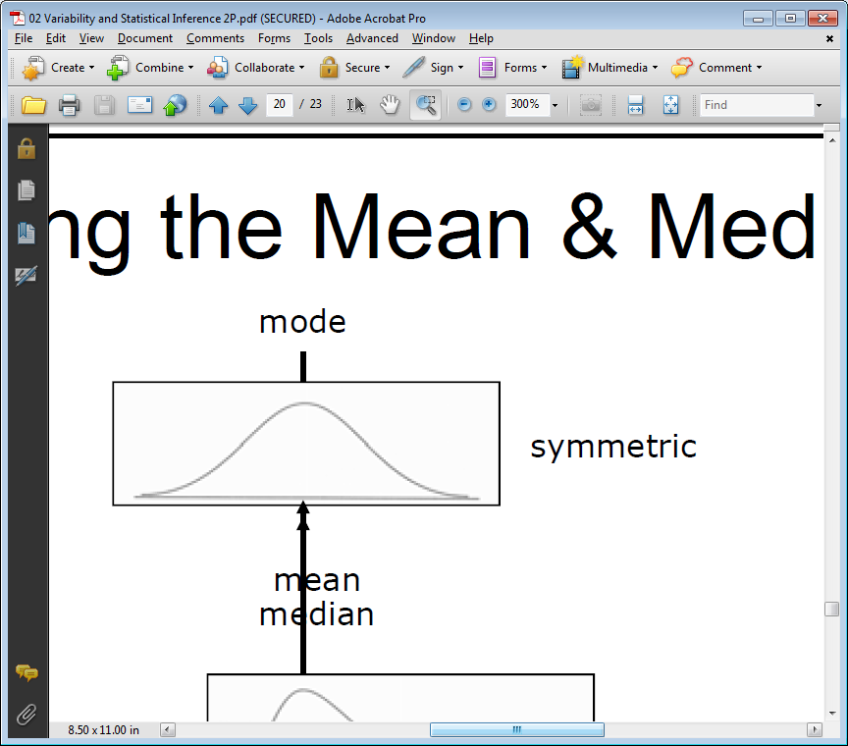
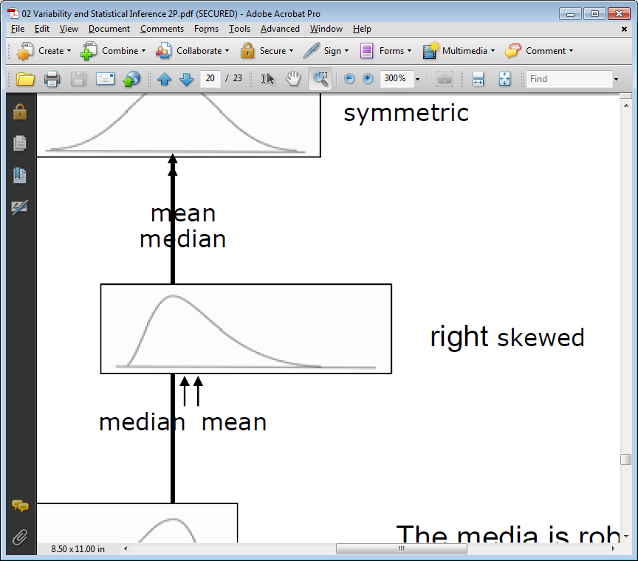
Descriptive statistics: measure of center
Which is more robust: the mean, or the median?
--median
Mode- occasionally used

Slide 8
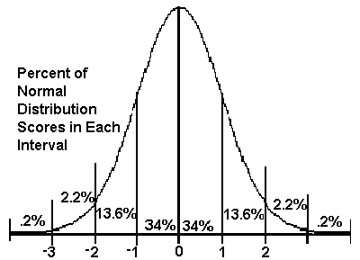
Descriptive statistics: measure of dispersion
Measures of dispersion
The Range – Nobody care!
Standard deviation – we’re familiar
Variance – square of SD
Coefficient of variation (CV) – SD expressed as percentage of mean
Standard Deviation
Two normal curves: same mean BUT different variance and SD
Do samples with same mean have the same SD?
-- NO
--Mean & SD are not dependent (i.e. vary independently)
-- are determined by the system under study

Slide 9
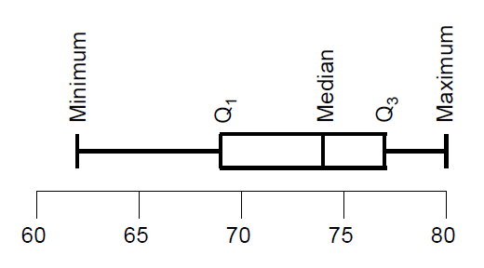
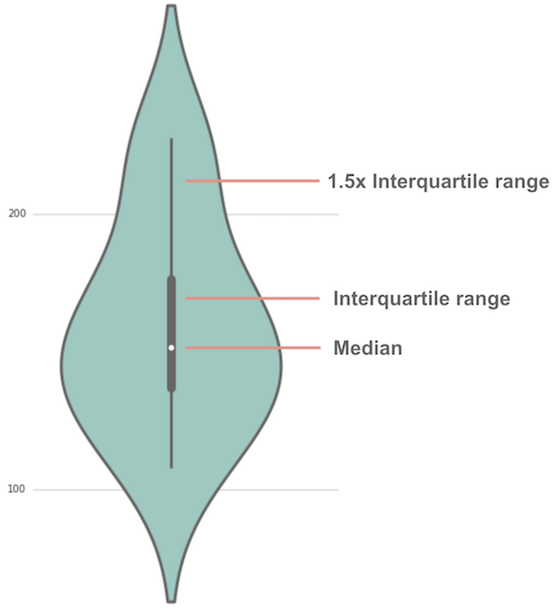
Descriptive statistics: measure of dispersion
Visualizing dispersion
BOXPLOT (five number summary)
Violin plot

Slide 10
Sample and Population
Population – e.g., treelines of the world, treelines of the Himalayas, treelines of the HM
Samples – e.g., treeline in Baima, treeline in Rara
Statistics – “the process of drawing conclusions about a population based on observations in a sample from the population”.
The basic assumption for hypothesis testing (test statistics), “Sample should represent the whole population”.

Slide 11
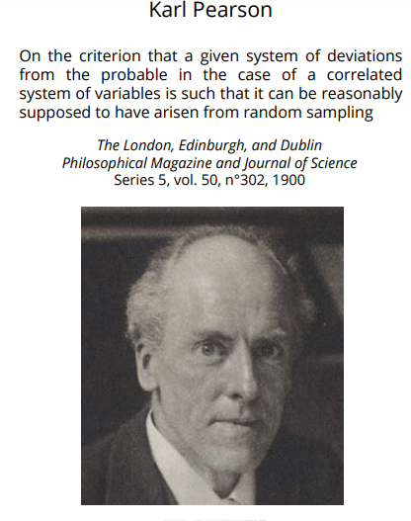
Probability distribution
P- value
"The probability of a complex system of n errors occurring with a frequency as great or greater than that of the observed system" (Pearson, 1900)
Wide applications in science for statistical hypothesis testing.

Slide 12
Probability distribution
What is probability? – the likelihood of something happening
Frequencies tend to converge on P as the iterations increase
What is the P value in hypothesis testing?
P is the probability of the observed data or more extreme data GIVEN that the null hypothesis is true.
There are several assumptions such as random sampling, correct model , independent cases etc.

Slide 13
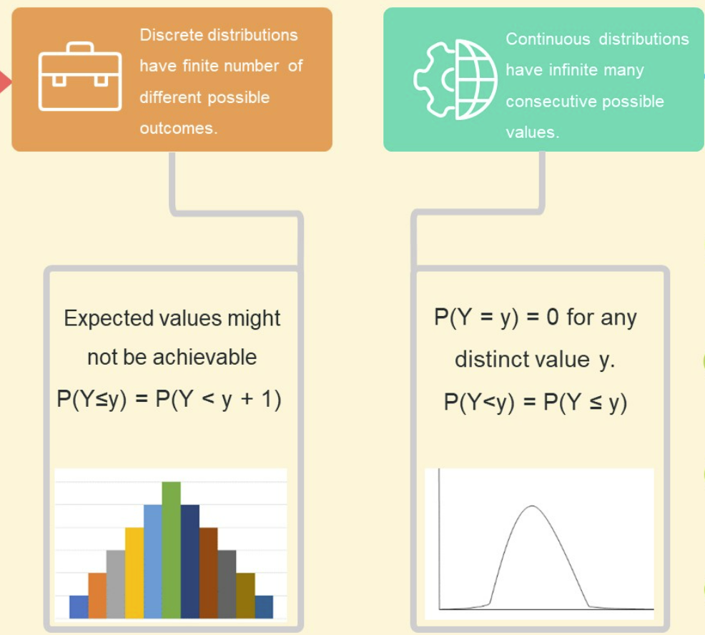
Probability distribution: Types
Discrete
Continuous
Discrete | Continuous
Bernoulli distribution | Normal/Gaussian distribution
Binomial distribution | Chi-squared distribution
Uniform distribution | Exponential distribution
Poisson distribution | Logistic distribution
 | Student’s T distribution
… etc | … etc

Slide 14
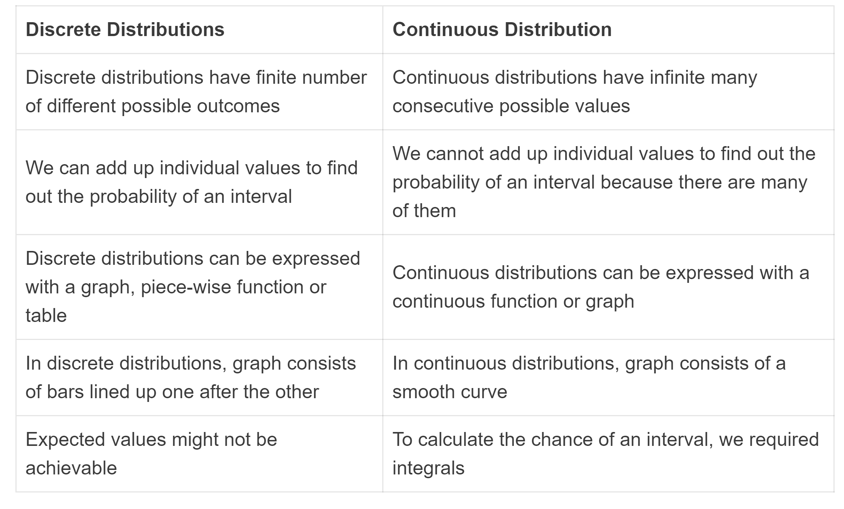
Probability distribution: Types

Slide 15
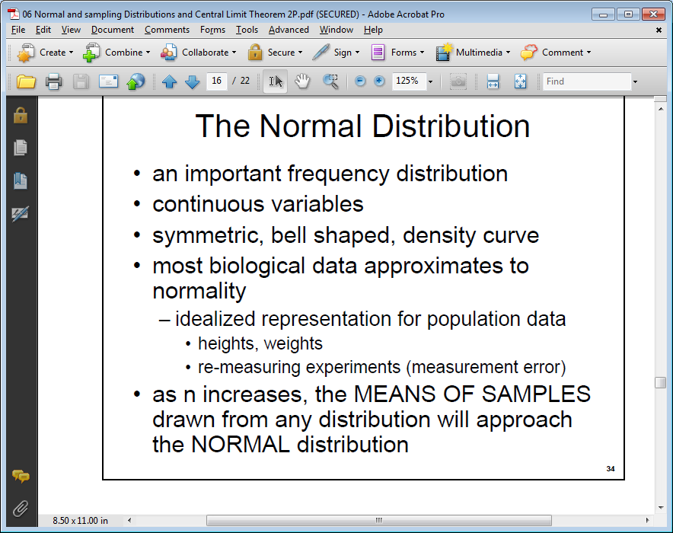
Probability distribution: Types
Normal distribution

Slide 16
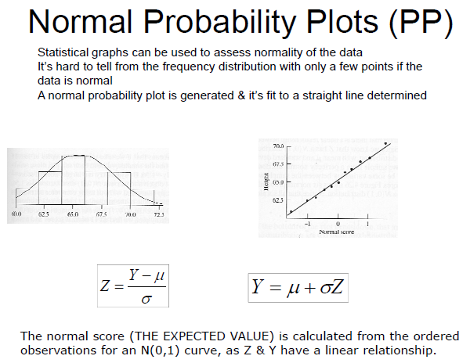

Slide 17
Probability distribution: Types
Normal distribution…

Slide 18
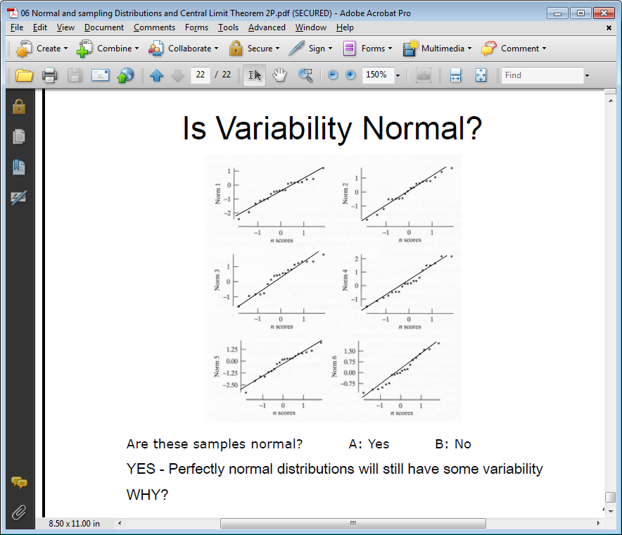
Probability distribution: Types
Normal distribution…

Slide 19
Probability distribution…
Types of error
Type-I error = Rejection of hypothesis H_{o} when H_{o} is true
Type-II error (Accepting false hypothesis) (consumer’s risk)
Type-II error = Acceptance of H_{o} is true
The degree of impact of Type-II error is more harmful than Type-I error.
 |  | STATISTICAL CONCLUSION
 |  | Accept H0 | Reject H0
REALITY | No effect | Correct decision No effect detected when none exists | Type I error Effect detected when none exists
 | Effect | Type II error Effect not detected | Correct decision Effect detected

Slide 20
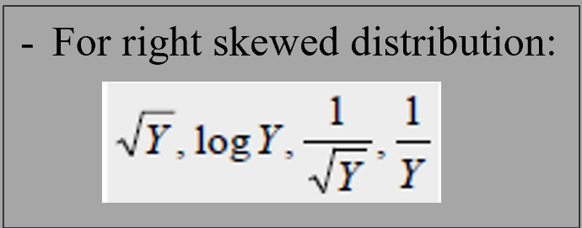
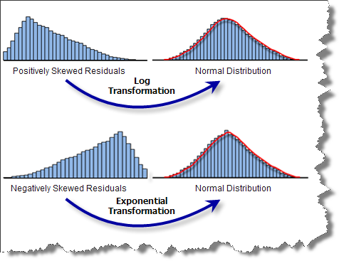
Data transformation
Transformation can convert data into a more normal frequency distribution.
Sq root transformation: mild right skewed data
--if ‘0’ values present in dataset, add +0.5 to each datum
Log transformation: heavily right skewed
--If ‘0’ values in dataset, add +1 is added to each datum
Arcsine/angular transformation: for proportion or ratio data (i.e., 0-1, 0-100)
Rank transformation: For non-parametric tests
--Default for many packages
Power transformation: for left skew, raise values to a power >1. e.g.,
--square transformation (not for ‘-ve’ values),
--exponential transformation (can be used for ‘-ve’ values)

Slide 21
Hypothesis Testing
Hypothesis
“A statement about one or more populations”
Draws statistical inference about a population by examining datasets (samples) from that population.
Research hypothesis:
The supposition or conjecture that motivates the research.
lead directly to the statistical hypotheses.
2. Statistical hypothesis:
hypotheses stated to be evaluated by appropriate statistical techniques.
Statistical Hypotheses
1. H₀: there is no difference in mean height between tropical and temperate trees
H_{o}: μ₁ = μ₂ → μ₁ – μ₂ = 0
2. H₁/H_{A}: There is a difference in height between the groups
H_{A}: μ₁ ≠ μ₂ → μ₁ – μ₂ ≠ 0
The null hypothesis is the one actually tested!!!

Slide 22
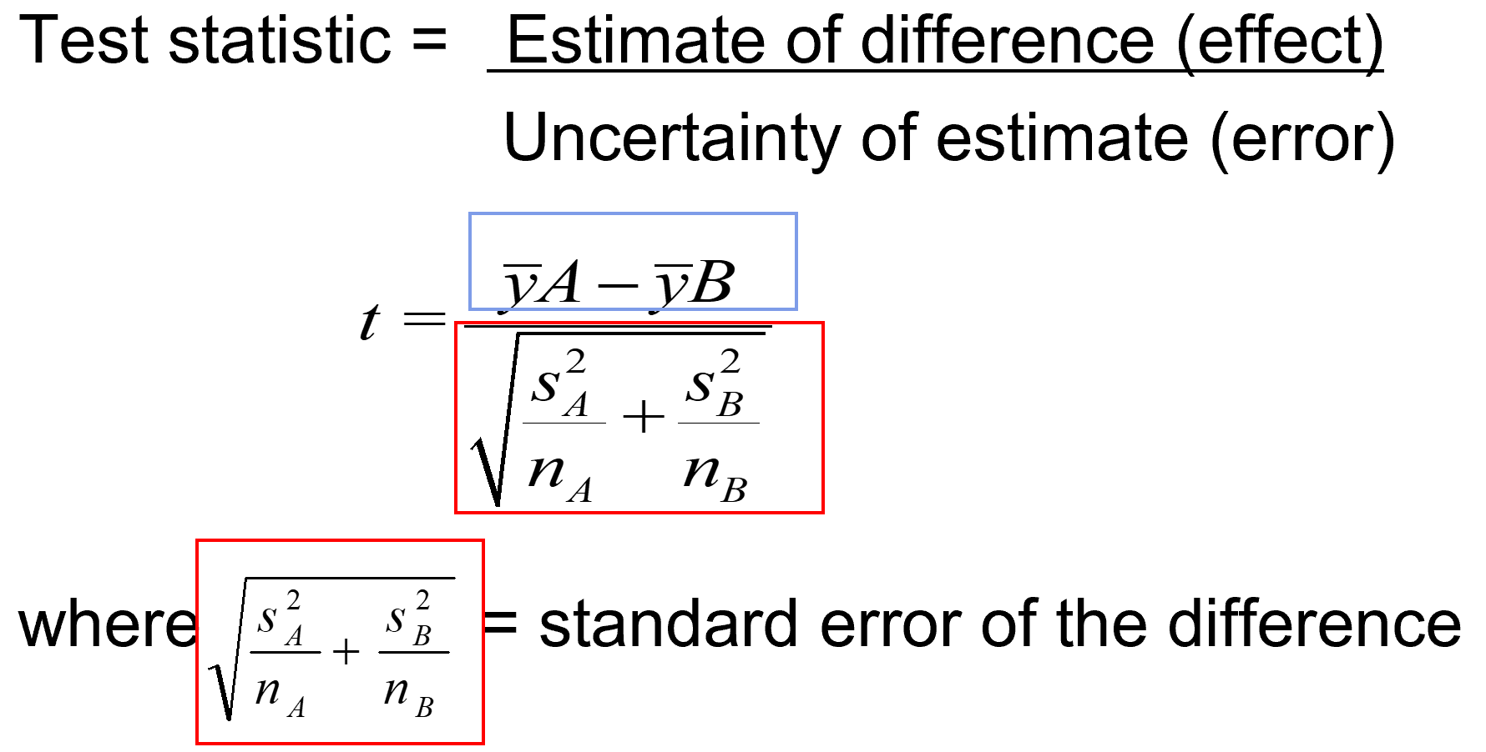
Hypothesis Testing…
Test statistics /statistical tests
A test statistics account the uncertainty in data due to the observed variation (sample variances)
more variation -> lower chance of finding a significant difference

Slide 23
Hypothesis Testing…
Test statistics…
Different types of test statistics used for hypothesis testing. Some commonly used test statistics are:
Z- test (Test of significance for large sample sizes, i.e. when n>30)
Students t- distribution (t- Test)
F- distribution (F- test and ANOVA)
Chi-square distribution (Chi- square test)
Symmetry & normality distibution of data: Parametric vs. non-parametric

Slide 24
Hypothesis Testing…
Determining statistical tests: Parametric vs. non-parametric
Parametric test:
Analysis of Variance (ANOVA)
t- tests
Pearson’s correlation
Regression
Non-parametric test:
Kruskal- Wallis test (non parametric ANOVA)
Wilcoxon-Mann-Whitney test (U or MW) (non parametric t-tests)
Chi-square test
Spearman rank correlation (and partial correlation ??)
Parametric test more powerful than non-parametric tests
Non-parametric tests are primarily for hypothesis testing and not for estimate of effect

Slide 25
Hypothesis Testing: Group comparisons
T-tests or mean tests
Most commonly used test statistics based on the mean (population/group).
Assesses whether the two means are significant different from each other or not.
T-tests types
1. One Sample t-test
- compare the mean of a group/sample to a fixed point, μ0
H0: μA = μ0 (H1: μA ≠ μ0)
2. Independent Sample t-test:
- compare the means of two groups (that are independent to each other)
H0: μA = μB (H1: μA ≠ μB)
3. Paired Sample t-test
paired data sampling units (each pair = one sampling unit).
E.g. Species richness in a plot for pre-monsoon and post-monsoon season.

Slide 26
Hypothesis Testing: Group comparisons
Assumptions for mean tests
Bivariate independent variable (A, B groups)
Continuous dependent variable
Each observations are independent of each others (dependent variable). Exception: For the paired t-test, only requires the paired-differences (A_{i} - B_{i}) be independent from each other (across i).
Normal distribution (Dependent variable),
Sample size less than 30

Slide 27
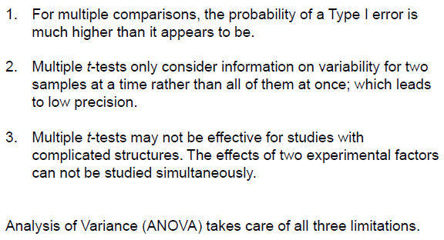
Hypothesis Testing: Group comparisons
Problems with multiple t-tests

Slide 28
Hypothesis Testing: Group comparisons
Analysis of variance (ANOVA)
->
ANOVA compares the mean difference between three or more groups.
ANOVA follows a different principle to t-tests.
tests whether a significant portion of variation in the data can be explained by differences between means of some of the groups
ANOVA types:
One way ANOVA
Repeated measures of ANOVA
Two way ANOVA
Three way/ multiple factor ANOVA
Multivariate analysis of variance (MANOVA)- (calculating mean of multiple dependent variables)

Slide 29
Hypothesis Testing: Group comparisons
Analysis of variance (ANOVA)
ANOVA assumptions
Check for: outliers, independence, constant variance, normality
Calculating residuals:
Residual = mean – an independent case
Standardized residual (SR) = residual / SD
<< SR- more useful in identifying outliers.
Check normality and variance
ANOVA Post-Hoc tests
Pairwise tests (between pairs of groups) based on different distributions (multiple comparison tests).
1. Least significant Difference (LSD)
2. Tukey HSD test
3. Student Newman Keuls (NKS)
4. Duncan’s Multiple Range test
5. Scheffé’s test
Tukey HSD is commonly used.

Slide 30
Hypothesis Testing: Group comparisons
ANOVA: Post hoc test
Step 1. Test homogeneity of variance (eg. Levene statistics).
a. If significance is >0.05, one may assume equal variances.
b. Otherwise, one may not assume equal variances.
Step 2. If assume equal variances, use F statistic to test hypothesis. If the test statistic's alpha = 0.05, then at least one group is significantly different from another group.
Step 3. Post hoc: If differences exist among the means, post hoc pairwise and multiple comparisons can be used to determine which means differ.
Step 4. Choose an appropriate post hoc test:
a. Unequal Group Sizes: Whenever you violate the equal n assumption for groups, select post hoc procedures: LSD, Games-Howell, Dunnett's T3, Scheffé, Dunnett's C.
b. Unequal Variances: Whenever the variance for groups is not equal (i.e., the homogeneity of variance assumption), check other post hoc procedures; eg., Tamhane’s T2, Games-Howell, Dunnett's T3, and Dunnett's C.

Slide 31
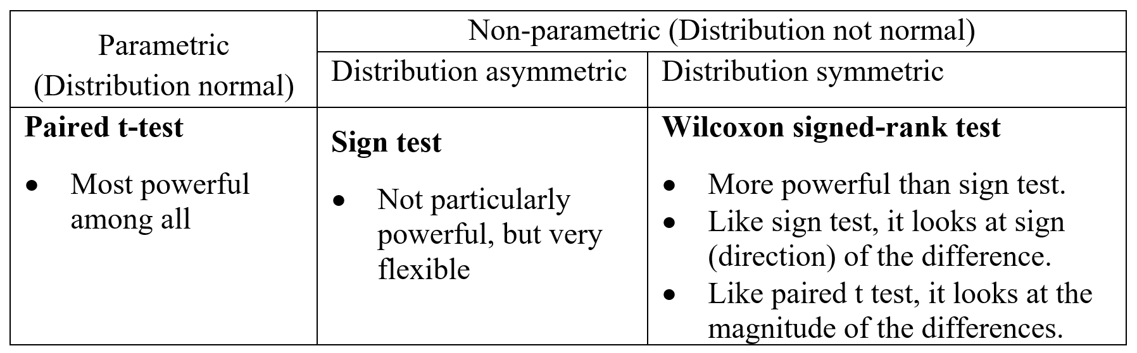
Hypothesis Testing: Group comparisons
Wilcoxon-Mann-Whitney test (WMW): non-parametric t-tests
Independent sample Wilcoxon test
An alternative independent-sample t-test.
Computed when data do not meet parametric tests assumptions
Paired-sample Wilcoxon test
Sign test and Wilcoxon signed-rank test are also used for one sample test

Slide 32
Hypothesis Testing: Group comparisons
Kruskal-Wallis test: non-parametric one-way ANOVA
An alternative for one way ANOVA
Computed when parametric tests assumptions (normality & homoscedasticity) are not permitted
Friedman test: non-parametric repeated measures of ANOVA
An alternative for repeated measures of ANOVA

Slide 33

Hypothesis Testing: Group comparisons
For detail about parametric assumptions, go to “Parametric assumptions_AFEC.ppt” file
You can search any queries easily at https://www.statmethods.net/ Quick-R: Home Page (statmethods.net)

Slide 34
Hypothesis Testing: Group comparisons
Let’s do practical together
[1] t-tests
[2] ANOVA

